Slide 1
https://www.geeksforgeeks.org/difference-between-ipsec-and-ssl/

Slide 2
Difference between Secure Socket Layer (SSL) and Transport Layer Security (TLS)

Slide 3
SSL stands for Secure Socket Layer while TLS stands for Transport Layer Security. Both Secure Socket Layer and Transport Layer Security are the protocols used to provide the security between web browser and web server.
The main differences between Secure Socket Layer and Transport Layer Security is that. In SSL (Secure Socket Layer), Message digest is used to create master secret and It provides the basic security services which are Authentication and confidentiality. while In TLS (Transport Layer Security), Pseudo-random function is used to create master secret

Slide 4
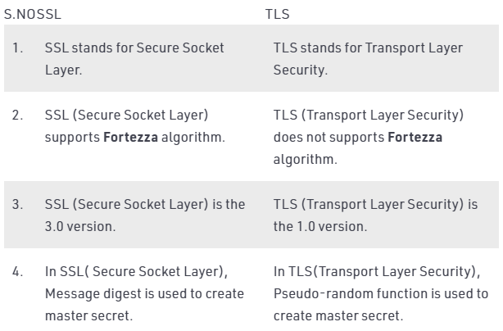

Slide 5
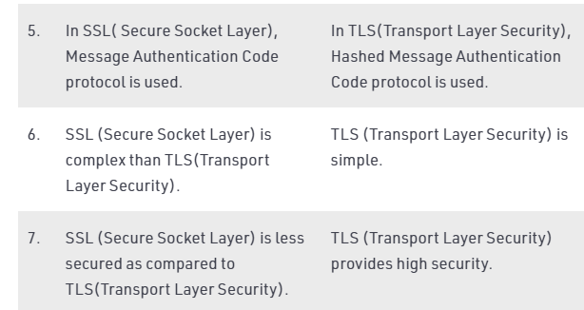

Slide 6
Difference between SSH and SSL
1. Secure Shell (SSH) : It is a cryptographic network protocol used to access the network devices and servers over the internet. SSH protocol was developed by SSH Communications Security Ltd. SSH allows us to log in securely into another computer over a network, to execute commands in a remote machine, and to transfer files from one machine to another through the network.
2. Secure Socket Layer (SSL) : It is a networking protocol which gives secure transmission in a non-secure network. SSL requires a certificate and works on the Public Key Encryption. SSL is implemented in various operations of networked environment such as web browsing, messaging, emails and other protocols like FTP.

Slide 7
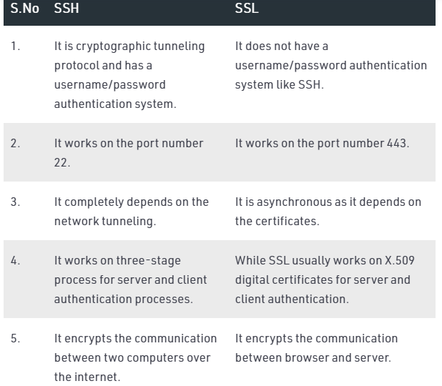

Slide 8
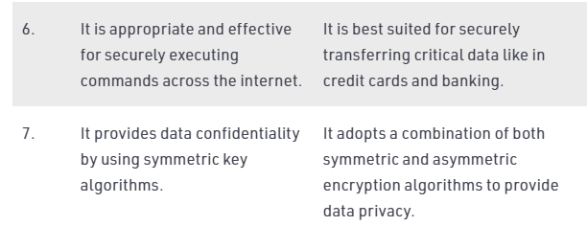

Slide 9
Secure Socket Layer (SSL)
Secure Socket Layer (SSL) provide security to the data that is transferred between web browser and server. SSL encrypt the link between a web server and a browser which ensures that all data passed between them remain private and free from attack.
Secure Socket Layer Protocols:
SSL record protocol
Handshake protocol
Change-cipher spec protocol
Alert protocol

Slide 10
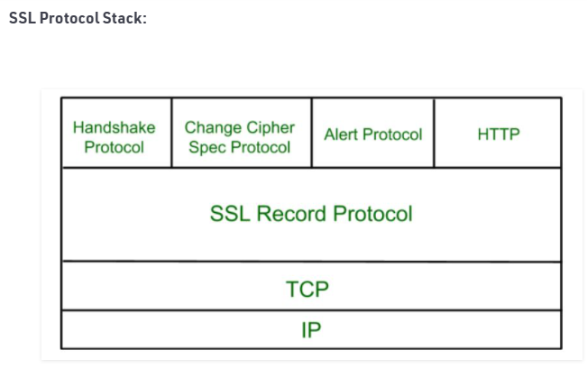

Slide 11
SSL Record Protocol: SSL Record provide two services to SSL connection.
Confidentiality
Message Integerity

Slide 12
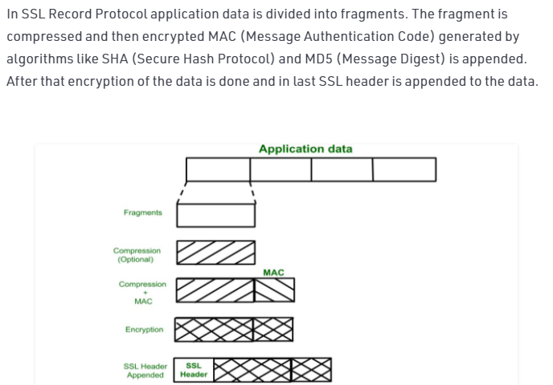

Slide 13
Handshake Protocol: Handshake Protocol is used to establish sessions. This protocol allow client and server to authenticate each other by sending a series of messages to each other. Handshake protocol uses four phases to complete its cycle.
Phase-1: In Phase-1 both Client and Server send hello-packets to each other. In this IP session, cipher suite and protocol version are exchanged for security purpose.
Phase-2: Server send his certificate and Server-key-exchange. Server end the phase-2 by sending Server-hello-end packet.
Phase-3: In this phase Client reply to the server by sending his certificate and Client-exchange-key.
Phase-4: In Phase-4 Change-cipher suite occurred and after this Handshake Protocol ends.

Slide 14
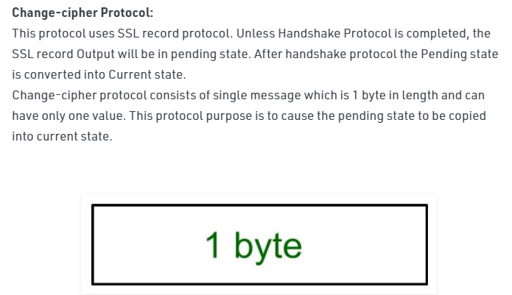

Slide 15
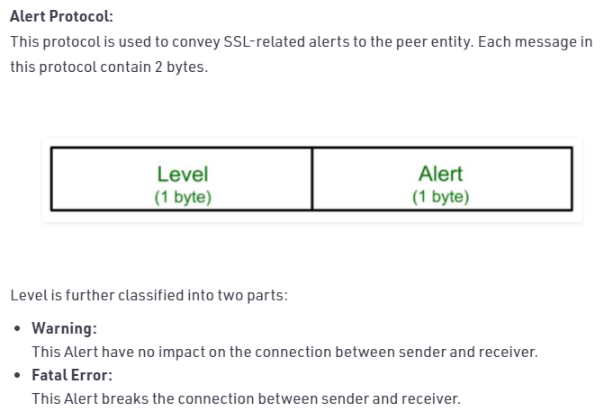

Slide 16
Silent Features of Secure Socket Layer:
Advantage of this approach is that the service can be tailored to the specific needs of the given application.
Secure Socket Layer was originated by Netscape.
SSL is designed to make use of TCP to provide reliable end-to-end secure service.
This is two-layered protocol.

Slide 17
Transport Layer Security (TLS)
Transport Layer Securities (TLS) are designed to provide security at the transport layer. TLS was derived from a security protocol called Secure Service Layer (SSL). TLS ensures that no third party may eavdrops or tamper with any message.

Slide 18
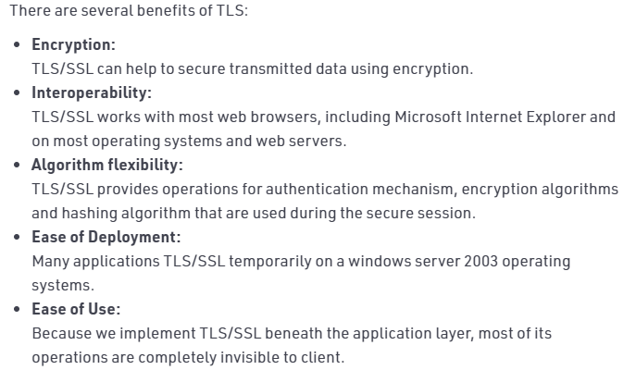

Slide 19
Working of TLS: The client connect to server (using TCP), the client will be something. The client sends number of specification:
Version of SSL/TLS.
which cipher suites, compression method it wants to use.

Slide 20
The server checks what the highest SSL/TLS version is that is supported by them both, picks a cipher suite from one of the clients option (if it supports one) and optionally picks a compression method. After this the basic setup is done, the server provides its certificate. This certificate must be trusted either by the client itself or a party that the client trusts. Having verified the certificate and being certain this server really is who he claims to be (and not a man in the middle), a key is exchanged. This can be a public key, “PreMasterSecret” or simply nothing depending upon cipher suite.
Both the server and client can now compute the key for symmetric encryption. The handshake is finished and the two hosts can communicate securely. To close a connection by finishing. TCP connection both sides will know the connection was improperly terminated. The connection cannot be compromised by this through, merely interrupted.

Slide 21
IP security (IPSec)
The IP security (IPSec) is an Internet Engineering Task Force (IETF) standard suite of protocols between 2 communication points across the IP network that provide data authentication, integrity, and confidentiality. It also defines the encrypted, decrypted and authenticated packets. The protocols needed for secure key exchange and key management are defined in it.

Slide 22
Uses of IP Security – IPsec can be used to do the following things:
To encrypt application layer data.
To provide security for routers sending routing data across the public internet.
To provide authentication without encryption, like to authenticate that the data originates from a known sender.
To protect network data by setting up circuits using IPsec tunneling in which all data is being sent between the two endpoints is encrypted, as with a Virtual Private Network(VPN) connection.

Slide 23
Components of IP Security – It has the following components:
Encapsulating Security Payload (ESP) – It provides data integrity, encryption, authentication and anti replay. It also provides authentication for payload.
Authentication Header (AH) – It also provides data integrity, authentication and anti replay and it does not provide encryption. The anti replay protection, protects against unauthorized transmission of packets. It does not protect data’s confidentiality.

Slide 24


Slide 25
3. Internet Key Exchange (IKE) – It is a network security protocol designed to dynamically exchange encryption keys and find a way over Security Association (SA) between 2 devices. The Security Association (SA) establishes shared security attributes between 2 network entities to support secure communication. The Key Management Protocol (ISAKMP) and Internet Security Association which provides a framework for authentication and key exchange. ISAKMP tells how the set up of the Security Associations (SAs) and how direct connections between two hosts that are using IPsec.Internet Key Exchange (IKE) provides message content protection and also an open frame for implementing standard algorithms such as SHA and MD5. The algorithm’s IP sec users produces a unique identifier for each packet. This identifier then allows a device to determine whether a packet has been correct or not. Packets which are not authorized are discarded and not given to receiver.

Slide 26
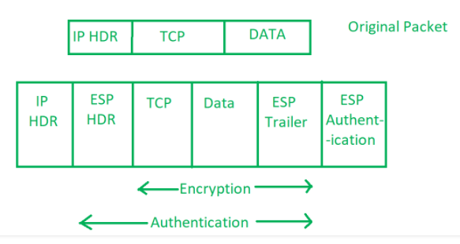

Slide 27
Working of IP Security –
The host checks if the packet should be transmitted using IPsec or not. These packet traffic triggers the security policy for themselves. This is done when the system sending the packet apply an appropriate encryption. The incoming packets are also checked by the host that they are encrypted properly or not.
Then the IKE Phase 1 starts in which the 2 hosts( using IPsec ) authenticate themselves to each other to start a secure channel. It has 2 modes. The Main mode which provides the greater security and the Aggressive mode which enables the host to establish an IPsec circuit more quickly.
The channel created in the last step is then used to securely negotiate the way the IP circuit will encrypt data accross the IP circuit.
Now, the IKE Phase 2 is conducted over the secure channel in which the two hosts negotiate the type of cryptographic algorithms to use on the session and agreeing on secret keying material to be used with those algorithms.
Then the data is exchanged across the newly created IPsec encrypted tunnel. These packets are encrypted and decrypted by the hosts using IPsec SAs.
When the communication between the hosts is completed or the session times out then the IPsec tunnel is terminated by discarding the keys by both the hosts.

Slide 28
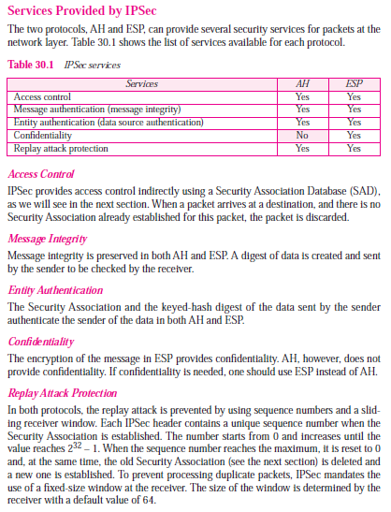

Slide 29
network scanning
The purpose of network scanning is to manage, maintain, and secure the system using data found by the scanner. Network scanning is used to recognize available network services, discover and recognize any filtering systems in place, look at what operating systems are in use, and to protect the network from attacks.

Slide 30
Types of Network Scanning Scanning has three types:
Port scanning - used to list open ports and services.
Network scanning - used to list IP addresses.
Vulnerability scanning - used to discover the presence of known vulnerabilities.

Slide 31
Network Scanning:
The purpose of each scanning process is given below:
Port Scanning – detecting open ports and services running on the target.
Network Scanning – IP addresses, Operating system details, Topology details, trusted routers information etc
Vulnerability scanning – scanning for known vulnerabilities or weakness in a system

Slide 32
Vulnerability scanning is an inspection of the potential points of exploit on a computer or network to identify security holes. A vulnerability scan detects and classifies system weaknesses in computers, networks and communications equipment and predicts the effectiveness of countermeasures.
Or
A vulnerability scan is an automated technology that attempts to identify vulnerabilities in your environment. A scan involves using a tool, such as Nessus or Qualys to run through a long list of checks to determine if you're affected by the vulnerabilities in their respective databases.

Slide 33
How do you perform a vulnerability scan?
Step 1: Conduct Risk Identification And Analysis. ...
Step 2: Vulnerability Scanning Policies and Procedures. ...
Step 3: Identify The Types Of Vulnerability Scans. ...
Step 4: Configure The Scan. ...
Step 5: Perform The Scan. ...
Step 6: Evaluate And Consider Possible Risks. ...
Step 7: Interpret The Scan Results.

Slide 34
Five types of vulnerability scanners
Network-based scanners. Network based vulnerability scanners identify possible network security attacks and vulnerable systems on wired or wireless networks.
Host-based scanners. ...
Wireless scanners. ...
Application scanners. ...
Database scanners.

Slide 35
What is vulnerability scanning?
Vulnerability scanning, also commonly known as ‘vuln scan,' is an automated process of proactively identifying network, application, and security vulnerabilities. Vulnerability scanning is typically performed by the IT department of an organization or a third-party security service provider. This scan is also performed by attackers who try to find points of entry into your network.
The scanning process includes detecting and classifying system weaknesses in networks, communications equipment, and computers. In addition to identifying security holes, the vulnerability scans also predict how effective countermeasures are in case of a threat or attack.
A vulnerability scanning service uses piece of software running from the standpoint of the person or organization inspecting the attack surface in question. The vulnerability scanner uses a database to compare details about the target attack surface.
The database references known flaws, coding bugs, packet construction anomalies, default configurations, and potential paths to sensitive data that can be exploited by attackers.
After the software checks for possible vulnerabilities in any devices within the scope of the engagement, the scan generates a report. The findings in the report can then be analyzed and interpreted in order to identify opportunities for an organization to improve their security posture.

Slide 36
Network Vulnerability Scan Categories
Network vulnerability scans can be categorized based on their use-cases:
Intrusive and non-intrusive methods
External vulnerability scan
Internal vulnerability scan
Environmental scan
Scanning Methods

Slide 37
We differentiate between two scan methods, non-intrusive vulnerability scans and intrusive vulnerability assessments. The non-intrusive method identifies a vulnerability and generates a report for the user to fix it. If a non-intrusive scanning method is used, no actual vulnerability exploitation occurs during this process: the scanner attempts to discover the probability of a vulnerability occurring given the conditions. Intrusive assessments, however, make attempts to exploit vulnerabilities after they are discovered during scanning and an attack plan is created.
The main benefit of the intrusive method is that the scan highlights the security risk as well as the impact of an exploited vulnerability. On the other hand, these scans could disrupt processes and operational systems in the network which can cause issues for both the customers and employees of an organization; therefore, intrusive scans should be used with caution.

Slide 38
Scanning Types
External vulnerability scans target the areas of an IT ecosystem that are exposed to the internet, or not restricted for internal use. These areas can include applications, ports, websites, services, networks, and systems that are accessed by external customers or users.
With internal vulnerability scans, the primary target of the software is the internal enterprise network. Once a threat agent makes it through a security hole, the threat agent can leave enterprise systems prone to damage. These scans search for and identify the vulnerabilities inside the network in order to avoid damage, as well as to allow organizations to protect and tighten systems and application security that are not exposed by external scans.
Environmental vulnerability scans are based on the specific environment of an enterprise’s technology operations. These vulnerability scans are specialized and are available to deploy for multiple technologies, such as IoT devices, websites, cloud-based services, and mobile devices.

Slide 39
How does vulnerability scanning work?
Depending on the type of scan the vulnerability platform uses, various techniques and tactics will be leveraged to elicit a response from devices within the target scope. Based on the devices’ reactions, the scanner will attempt to match the results to a database and assign risk ratings (severity levels) based on those reactions.
Vulnerability scanners can be configured to scan all network ports, detecting and identifying password breaches as well as suspicious applications and services. The scanning service reports security fixes or missing service packs, identifies malware as well as any coding flaws, and monitors remote access.

